Slide 1
Lesson-6: Iteration
This lesson is an iteration of our coding workshops
Ben Schwarz

Slide 2
Often we want to repeat things.
For example let’s say we had instructions for eating cereal. It would look something like:
Put cereal in bowl
Add milk to cereal
Dip spoon into cereal and milk and then place spoon in mouth.
Repeat step 4 until all cereal and milk is eaten
Rinse bowl and spoon
Using iteration makes this algorithm possible.
There are two main types of loops in java: While loops – which loop while something is true and for loops – which loop for a certain set number of iterations.

Slide 3
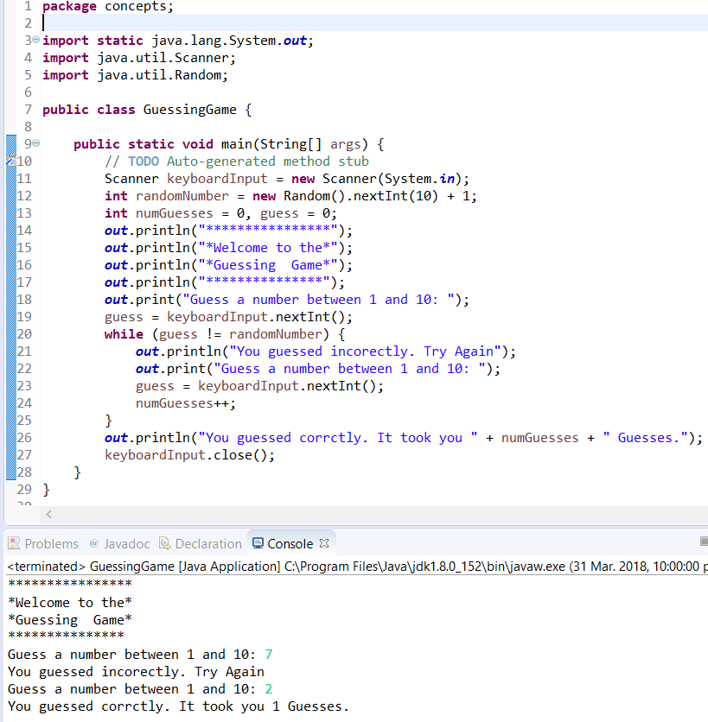
While loop
A while loop runs a block of code if a condition inside a parenthesis is true (like an if statement). Here is a example:
Note: the static import you won’t understand for now but the explanation is that out isn’t a class but a static field in the System class. This will make sense later. This saves space as I don’t have to write System.out.
It is possible to make a while loop run forever. But you should avoid it.
Activity: Make a while loop that counts to 4613 and outputs it’s progress.

Slide 4

For loop
Now loops are also useful for counting things. You can use while loops to count up things, as you did with Activity 1. But there is in fact a better way. That better way is called a for loop!
They're quite a bit more complicated than while loops syntax wise. Look at the example, try to figure out what's happening, and then I'll deconstruct it.

Slide 5
Deconstruction of for loop
This code does what we did in activity one.
for – Java Keyword for a for loop. Obviously
int counter=1; – creates a new variable. It usually starts at 0 but I chose 1 to illustrate a purpose. This always comes first.
count<=4613; - this says when the loop should run. This comes second
counter++) {- this dictates what happens at the end of each loop. This comes third. It ends the for and opens the loop block.
Activity: Make a for loop which starts at 4613 and counts backwards to -4613. Why one would want to do this. Who knows?

Slide 6

Do-while
While loops only run when their condition is true. However, what if you want to run some code once, check the condition and then loop. For e.g. a password.
This requires the help of a do-while:
Activity: You have the answer to the world’s bestest number locked in a safe which only you have the password to. Write a program to ask for a password. Print it out if the password is correct. Loop asking for a password with a do-while loop.

Slide 7
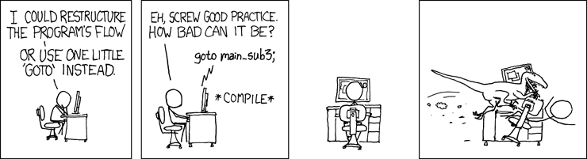
Goto/ break/ continue
There are some… alternative facts ways to jump around in code.
These are goto, break and continue. However, they have the tendency to make code messy, unreadable and make spaghetti code (convoluted code with a broken and impossible to understand structure).
Goto actually used to be in Java, but got removed because it's so bad. Goto lets you jump to specific lines of code. Break will exit a loop. Continue will begin the current loop again.
Not only are goto’s and other horrors bad, but we are legally obligated to warn you that it is a major OSHA healthplace work and safety hazard:

Slide 8
Activities:
If we list all the (positive integer) numbers below 10 that are multiples of 3 or 5, we get 3, 5, 6 and 9. The sum of these multiples is 23. Find the sum of all the multiples of 3 or 5 below 1000.
The Fibonacci sequence is generated by adding the previous two terms to create the next term. Starting with 1, it goes 1, 1, 2, 3, 5, 8, 13, 21, 34, 55, 89. Find the sum of numbers in the Fibonacci Sequence, that are less than four million, and are divisible by 8.
Find the 4613th prime number.
This are all a step up from the previous activities. However, I think you can do them all. If doing this at home don’t spend more than 15min on each.
Source: I stole took inspiration from many of the problems on projecteuler.net . Activity 1 is problem 1, activity 2 is problem 2. *Actually Tom took from there. I “borrowed” them from him.

